Slide 1
Time Series Prediction for Food Sustainability
IT 833 Advanced Time Series Analysis
Guided by:
Dr. Biju R Mohan
Presented By:
Amrit Mohapatra 222IT004
Natasha Jain 222IT023

Slide 2
INTRODUCTION
Time series prediction for food sustainability involves using historical data to forecast future trends in food production, consumption, and waste.
The goal of such predictions is to identify potential issues and opportunities for sustainable food systems, such as reducing food waste, increasing food access, and improving the efficiency of food production.
Some key factors that can impact food sustainability include climate change, population growth, economic factors, and technological advancements.
By analyzing trends and patterns in these factors over time, it is possible to make informed predictions about future food sustainability..

Slide 3
LITERATURE SURVEY
Paper | Author | Year | Work Done | Drawbacks
“Food Demand Prediction Using the Nonlinear Autoregressive Exogenous Neural Network," in IEEE Access, vol. 9, pp. 146123-146136, 2021, | K. Lutoslawski, M. Hernes, J. Radomska, M. Hajdas, E. Walaszczyk and A. Kozina | 2021 | They used nonlinear autoregressive neural network. The solution is made up of data that was gathered through NARXNN training sessions spanning over three and a half years. | The main limitation of the developed models is the lack of the possibility of analysing small datasets
, "Machine Learning based Prediction of GDP using FAO Agricultural Data Set for Hungary," | Adedeji Charles Adeyemo; Bence Bogdandy; Zsolt Toth | 2021 | This paper presents experimental results on training various recurrent neural networks for modeling the changes of Agricultural and Gross Domestic Products. | Although the results from GRU are promising, it poses the challenge of training the network appropriately. .
Regional yield prediction for winter wheat based on crop biomass estimation using multi-source data | Jianqiang Ren; Su Li; Zhongxin Chen; Qingbo Zhou; Huajun Tang | 2007 | Judged from the results of validation, the method was effective and practical in yield estimation of winter wheat in a larger region | regionalizing and optimizing the relationship between fPAR and MODIS-NDVI is the next work which should be done better.
Machine Learning for Price Prediction for Agricultural Products | Sussy Bayona-Oré, Rino Cerna Eduardo, Tirado Hinojoza | 2021 | The results show that the mostly commonly used research paradigm is positivism, the research is quantitative and longitudinal in nature and neural networks are the most commonly used algorithms. | Machine learning algorithms can be complex and difficult to interpret, making it challenging for farmers to understand the reasoning behind the predictions.

Slide 4
LITERATURE SURVEY
Paper | Author | Year | Work Done | Drawbacks
Food in the Anthropocene: the EAT–Lancet Commission on healthy diets from sustainable food systems. | Willett W, Rockström J, Springmann M, Vermeulen S, et al | 2019 | According to the results of the studies, this model attained higher levels of performance and accuracy. | The report emphasizes a universal approach to healthy and sustainable diets, without taking into account cultural and traditional dietary patterns of different regions and populations.
Predicting Future Food Security in Sub-Saharan Africa: A Time Series Approach | R. M. J. Kadigi and S. G. Mwakaje | 2022 | The authors identify key factors that impact food security, such as climate change and population growth, and use statistical techniques to make predictions about future trends. | One potential drawback of these papers is that the accuracy of the predictions relies heavily on the quality and availability of the data used
Food Sustainability Index: A Time-Series Analysis | L. A. Zaccarelli, G. Pellegrini, and R. P. H. Peters | 2019 | The authors analyze a variety of factors, such as agricultural productivity, food waste, and food affordability, and use statistical techniques to identify trends and patterns. | use complex models or statistical techniques that may be difficult to understand for individuals who are not familiar with these methods
Predicting Food Prices and Availability Using Machine Learning: Evidence from Brazil. | L. N. R. Chagas, M. C. Lopes, and M. C. S. Barreto | 2021 | The authors analyze a variety of data sources, such as weather patterns and economic indicators, and use machine learning algorithms to identify patterns and make predictions. | have assumptions and limitations that impact the validity of the predictions the models used may assume that historical patterns will continue into the future, which may not always be the case in a rapidly changing world.
Forecasting Future Food Security in Asia: A Time Series Analysis. | R. K. Singh, A. Kumar, and P. B. Shyam | 2021 | The authors analyze a variety of factors, such as agricultural productivity, food prices, and population growth, and use statistical techniques to make predictions about future trends. | It may not be possible to generalize the findings to other regions or time periods, as different factors may impact food sustainability in different ways.

Slide 5
PROBLEM STATEMENT
The project is to use a machine learning system that can forecast the top-k food products that might experience a scarcity in each nation during a given time in the future.

Slide 6
OBJECTIVE
To use historical data on food production, consumption, and other relevant factors to forecast future food supply and demand trends.
This technique will make it easier for businesses and manufacturers to comprehend how much productivity and sustainability are required to meet the world's demand.
To Analyze patterns and trends in the data, time series prediction models can help identify potential challenges and opportunities for improving food sustainability, such as predicting crop failures, identifying areas where food production needs to be increased, or forecasting changes in consumer demand for certain types of food.

Slide 7
DATASET
The dataset for the solution is provided by Food and Agriculture Organization Corporate Statistical Database (FAOSTAT). The database provides free access to food and agriculture data for over 245 countries and territories and covers all FAO regional groupings from 1961 to the most recent year available (2019). The three datasets chosen from this database are as follows,
● Climate Change: Emissions Totals
● Forestry: Forestry Production and Trade
● Production: Crops and livestock products

Slide 8
METHODOLOGY
Preprocessing the dataset
Removing unwanted features like Area, Source and Emission Unit
Removing redundant instances
Removing features having NaN values
Create pivot table for production items + forestry products based on year and item
Perform Granger causality test: - A statistics test to check whether one variable influences the prediction of another variable.
Perform Augmented Dickey–Fuller (ADF) Test - Statistical test used to test whether a given time series is stationary or not.

Slide 9
METHODOLOGY
Perform 1st and 2nd differencing to modify non-stationary series to stationary one.
Train dataset with VAR model (each item is trained against different emissions as a separate model).
With the forecast output - perform inverse transformation to get back values in original scale
Find the top-k items that endure shortage by particular year.
Visualize the production graphs for top-k items.

Slide 10
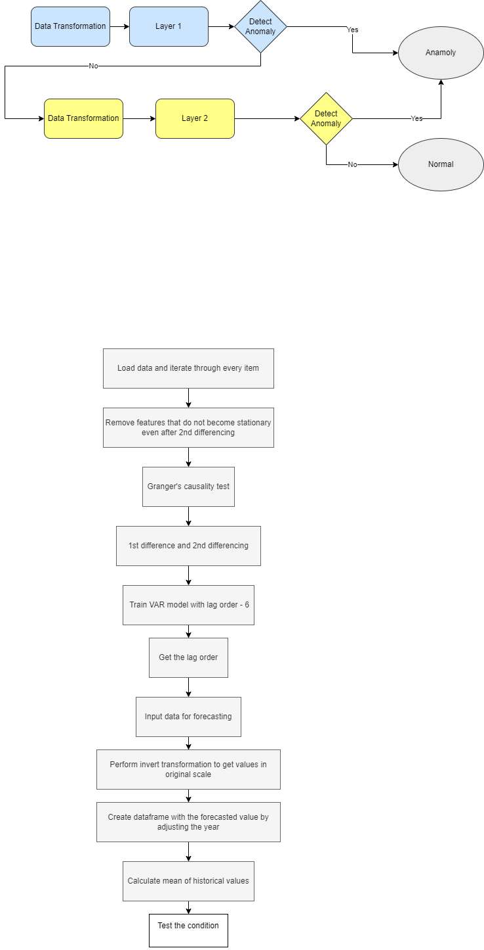
METHODOLOGY

Slide 11
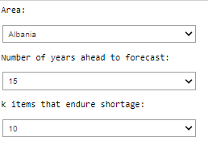
USER INPUT
User Input (For training and inference) :
Select the area for which you want to predict
For how many year ahead you want to forecast
Number of items

Slide 12
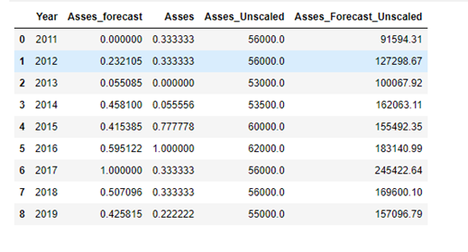
Granger Causality Test
A statistics test to check whether one variable influences the prediction of another variable.

Slide 13
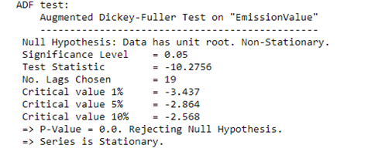
Augmented Dickey–Fuller (ADF) Test
Statistical test used to test whether a given time series is stationary or not.

Slide 14
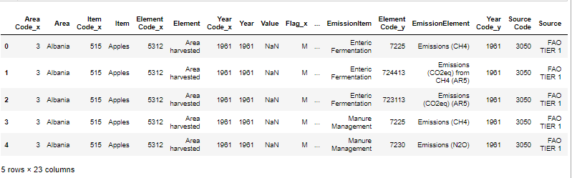
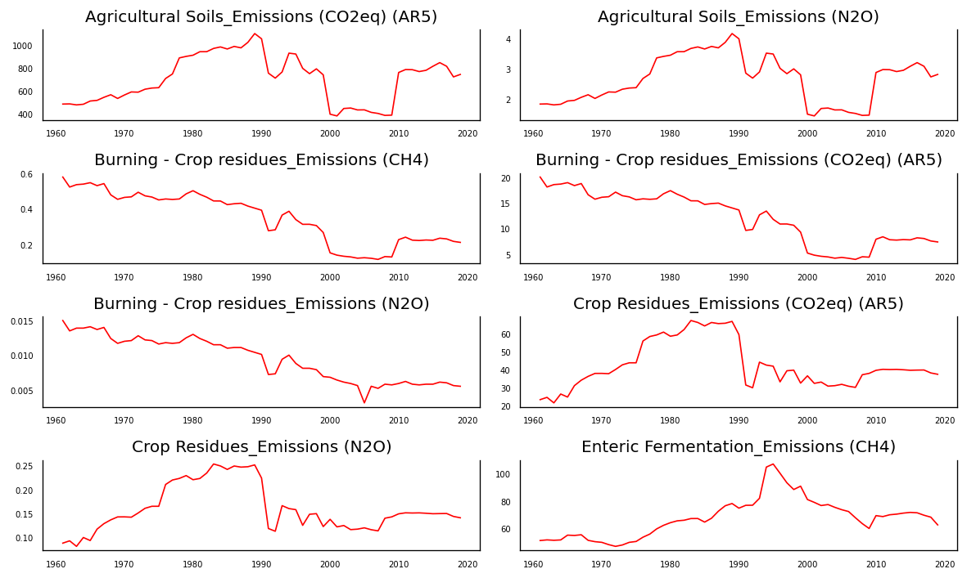
DATA VISUALISATION
Fig.Data visualisation for Climate Change: Emissions Totals

Slide 15
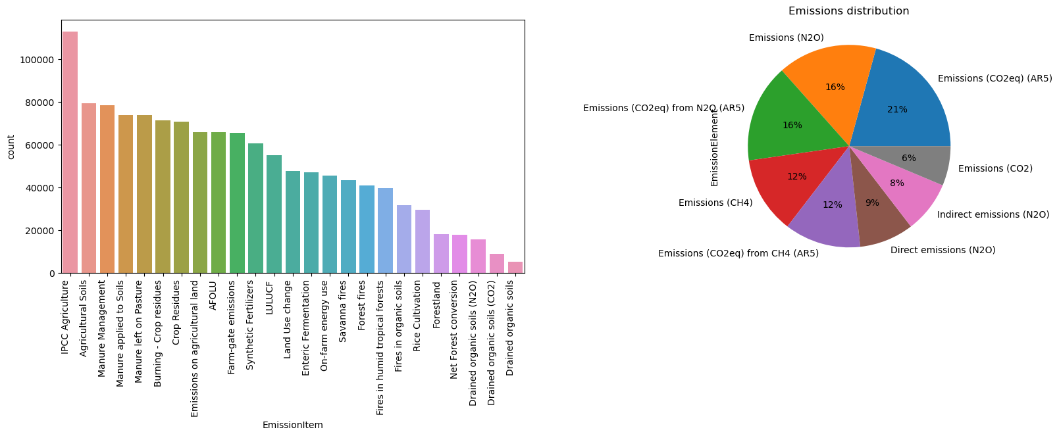
DATA VISUALISATION
Fig.Data visualisation for Climate Change: Emissions Totals

Slide 16
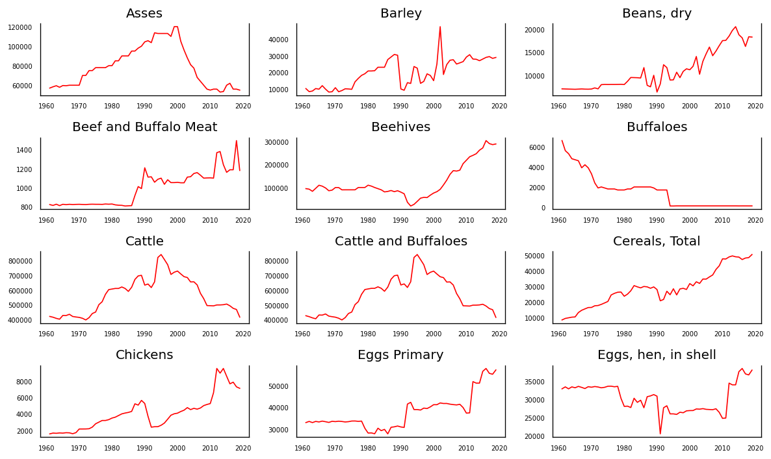
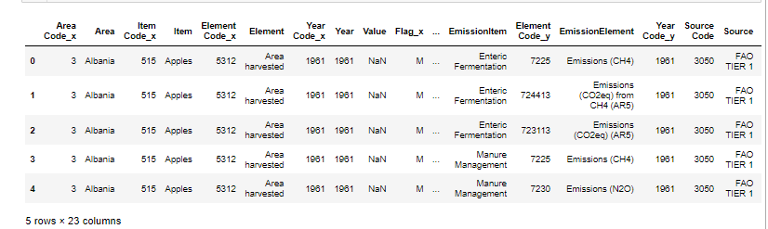
DATA VISUALISATION
Fig.Data visualisation for Forestry: Forestry Production and Trade

Slide 17
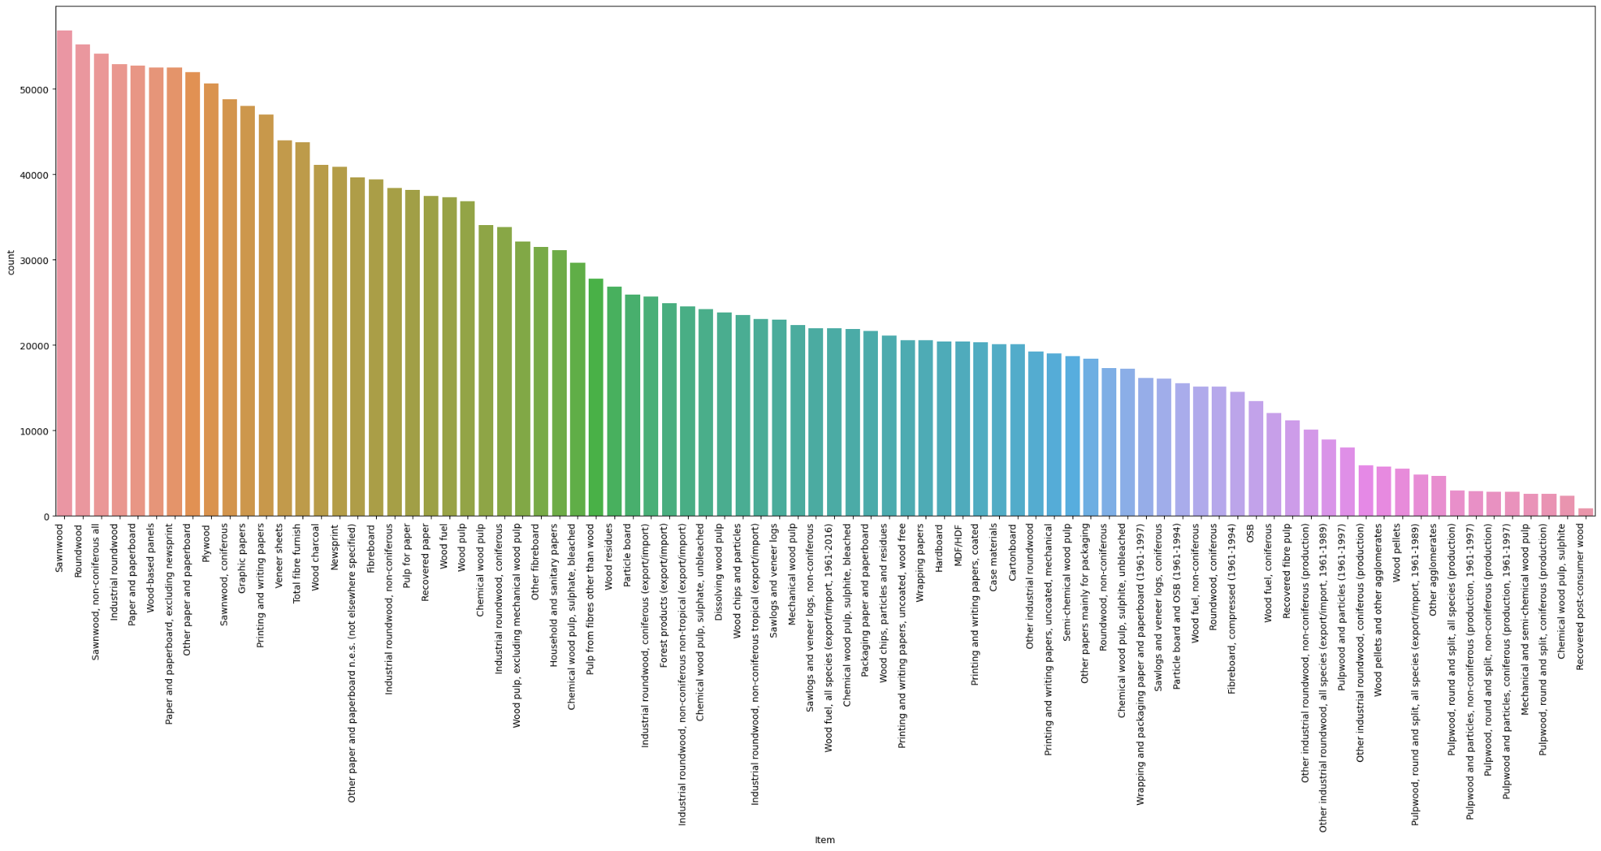
DATA VISUALISATION
Fig.Data visualisation for Forestry: Forestry Production and Trade

Slide 18
DATA VISUALISATION
SET
Fig.Data visualisation for Production: Crops and livestock products

Slide 19
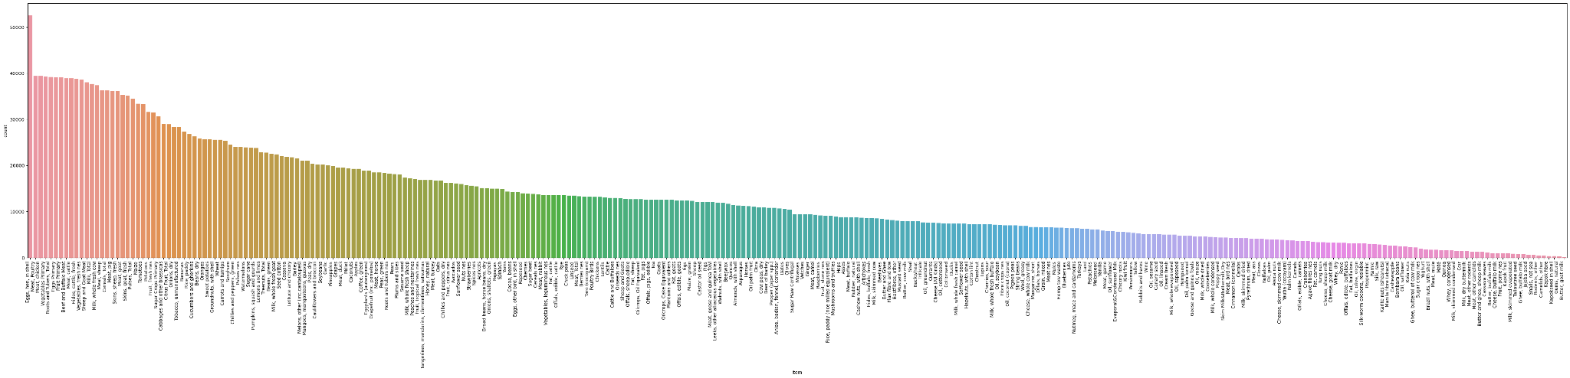
DATA VISUALISATION
Fig.Data visualisation for Production: Crops and livestock products

Slide 20
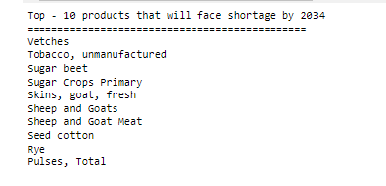
PREDICTED OUTPUT

Slide 21
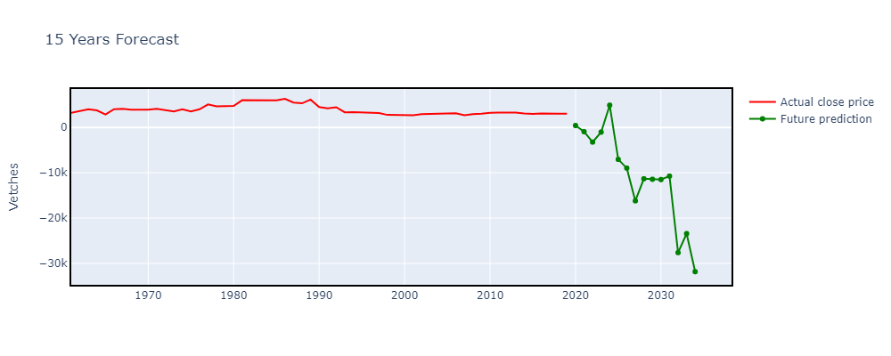
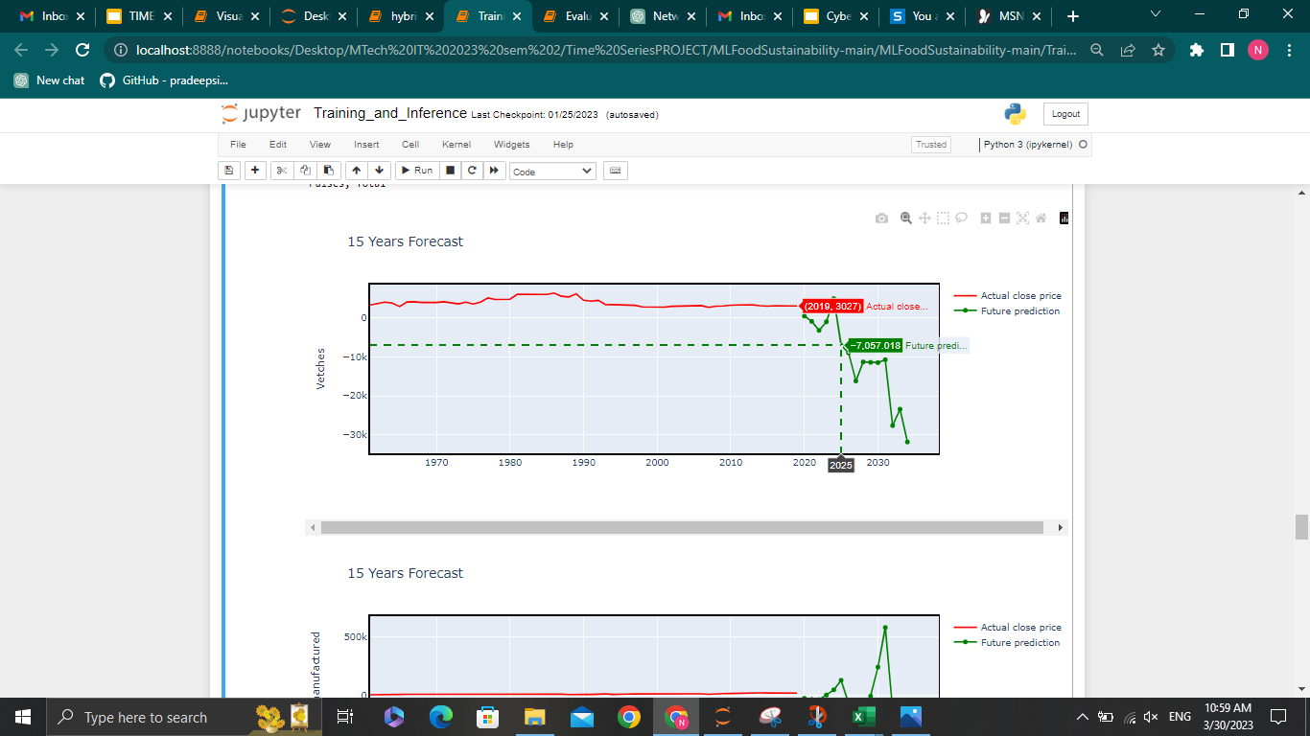
EVALUATION RESULTS
Fig.Predicted Output for vetches for Albania

Slide 22
EVALUATION RESULTS
In order to evaluate the performance of the trained model, the experiment is repeated differently.
The dataset is split into a training set (50 historical values - 1961 to 2010) and an evaluation set (9 historical values - 2011 to 2019).
The data is trained with a VAR model .
The model is used to forecast the future nine values.
The predicted values are compared against the evaluation set to calculate the evaluation metrics

Slide 23

USER INPUT
Taking Input from the user for the area for which they want to see the results

Slide 24
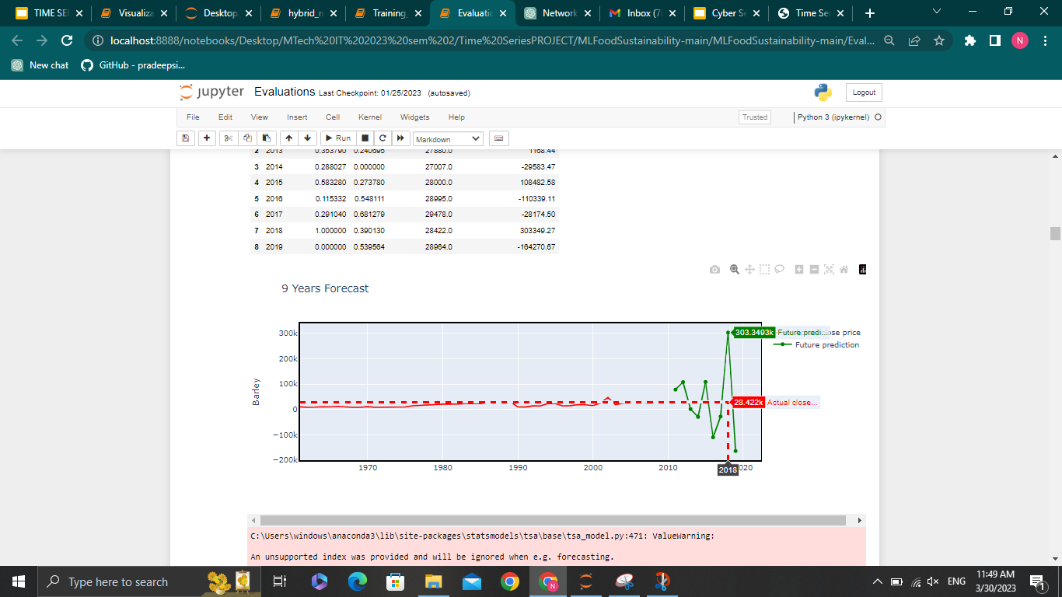
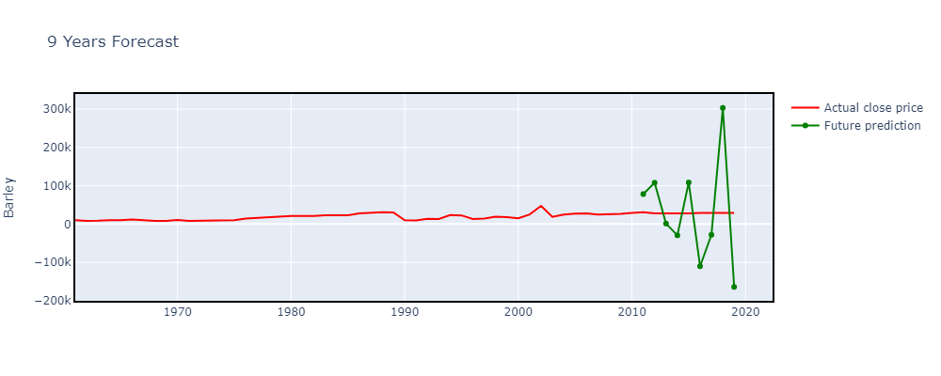
EVALUATION RESULTS OF VAR MODEL
Fig.Comparing output of actual trend and the trend predicted by model of VAR model

Slide 25
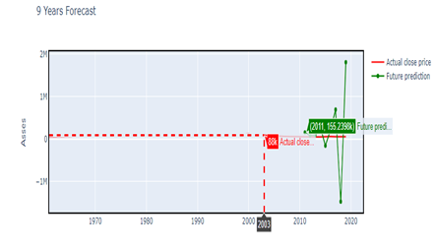
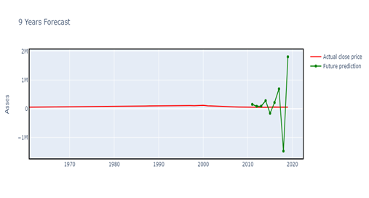
EVALUATION RESULTS OF VECM MODEL
Fig.Comparing output of actual trend and the trend predicted by model of VECM model

Slide 26
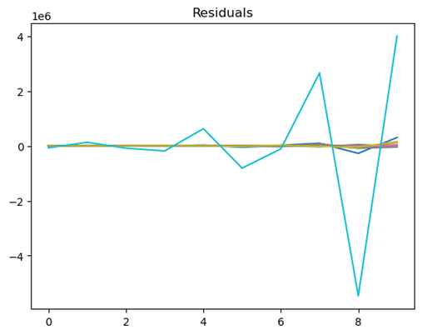
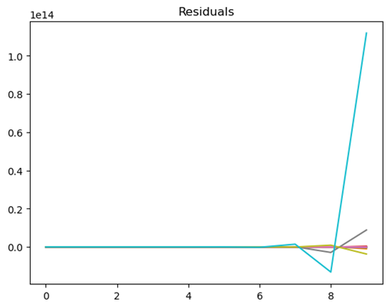
RESIDUAL ANALYSIS
Fig.Residual Analysis of VAR model
Fig: Residual Analysis of VECM model

Slide 27
EVALUATION METRICS
 | VAR | VECM
Mean absolute error | 0.3916 | 0.43433
Mean squared error | 0.23006 | 0.26571
Root mean squared error | 0.4622 | 0.504205
MAE = (1/n) * Σ|yi – xi |
MSE = (1/n) * Σ(yi – xi)^2
RMSE = √(Σ(yi – xi)^2/ n )

Slide 28
CONCLUSION
The research project focuses on creating a system that can predict the production of crops,livestock and forestry products under the influence of gases using the Vector Autoregression (VAR) model.
The proposed solution uses the food and agriculture database from the United Nations to train a vector autoregressive model.
The forecast model can project trends of production quantities and the top-k items that would endure shortage in the future.
The results of the solution help in understanding the importance of sustainability to make the necessary lifestyle changes in developed countries before it is too late.
In underdeveloped and developing countries, the results could help the government and agriculturists produce the right quantity of food products to satisfy the country's demand.

Slide 29
REFERENCES
[1] K. Lutoslawski, M. Hernes, J. Radomska, M. Hajdas, E. Walaszczyk and A. Kozina, "Food Demand Prediction Using the Nonlinear Autoregressive Exogenous Neural Network," in IEEE Access, vol. 9, pp. 146123-146136, 2021, doi: 10.1109/ACCESS.2021.3123255.
[2] Jianqiang Ren, Su Li, Zhongxin Chen, Qingbo Zhou and Huajun Tang, "Regional yield prediction for winter wheat based on crop biomass estimation using multi-source data," 2007 IEEE International Geoscience and Remote Sensing Symposium, 2007, pp. 805-808
[3] Q. Chen, X. Lin, Y. Zhong and Z. Xie, "Price Prediction of Agricultural Products Based on Wavelet Analysis-LSTM," 2019 IEEE Intl Conf on Parallel & Distributed Processing with Applications, Big Data & Cloud Computing, Sustainable Computing & Communications, Social Computing & Networking (ISPA/BDCloud/SocialCom/SustainCom), 2019, pp. 984-990, doi: 10.1109/ISPA-BDCloud-SustainCom-SocialCom48970.2019.00142
[4] A. C. Adeyemo, B. Bogdandy and Z. Toth, "Machine Learning based Prediction of GDP using FAO Agricultural Data Set for Hungary," 2021 IEEE 15th International Symposium on Applied Computational Intelligence and Informatics (SACI), 2021, pp. 000473-000478, doi: 10.1109/SACI51354.2021.9465608.
[5] Willett W, Rockström J, Loken B, Springmann M, Lang T, Vermeulen S, et al. Food in the Anthropocene: the EAT–Lancet Commission on healthy diets from sustainable food systems. The Lancet. 2019 Jan 16.

Slide 30
THANK YOU

